Slide 1

JAMES WEBB
BY,
MUHAMMED RAKIN US 21EIR058
SUGHAMBIGA S 21EIR092
VISHNU S 21EIL120

Slide 2
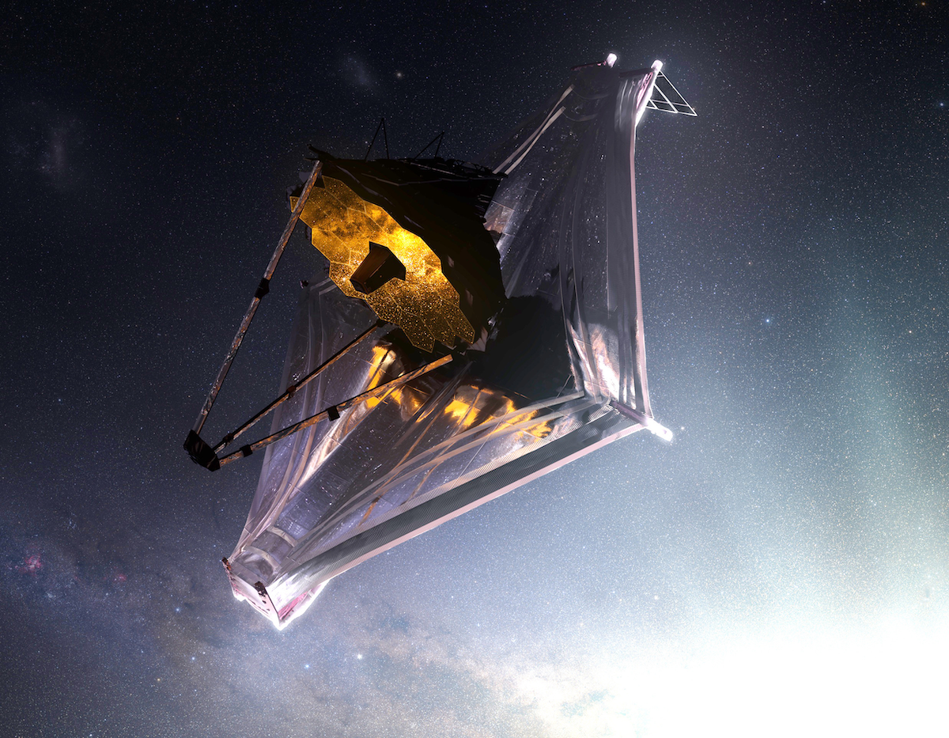
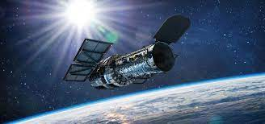
What is jwst?
The James Webb Space Telescope (JWST) is a space telescope developed by NASA with contributions from the European Space Agency (ESA) and the Canadian Space Agency (CSA). The telescope is named after James E. Webb, Who was the administrator of NASA from 1961 to 1968 played an integral role in the Apollo program.

Slide 3
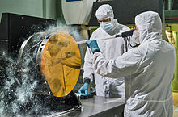
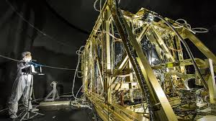
Construction:

Slide 4
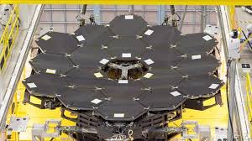
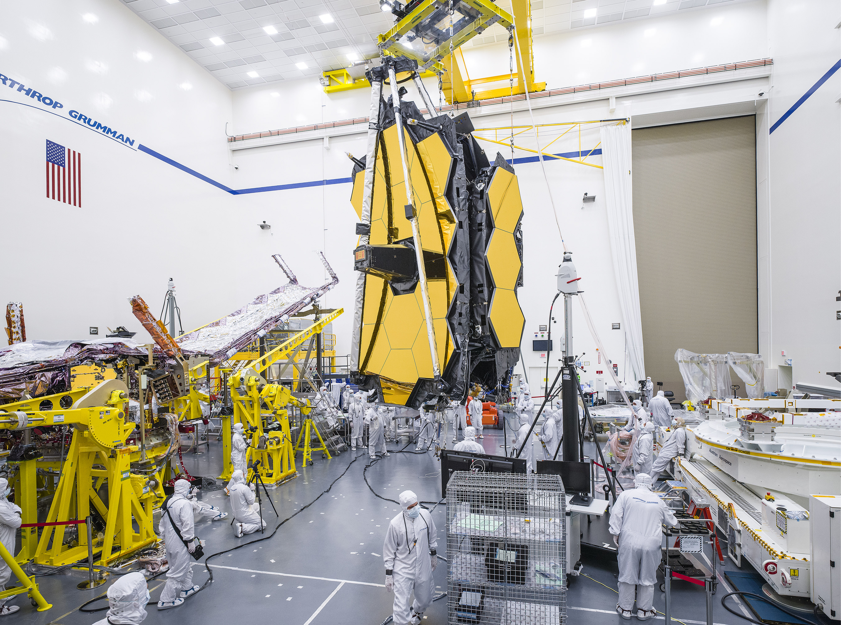

Slide 5
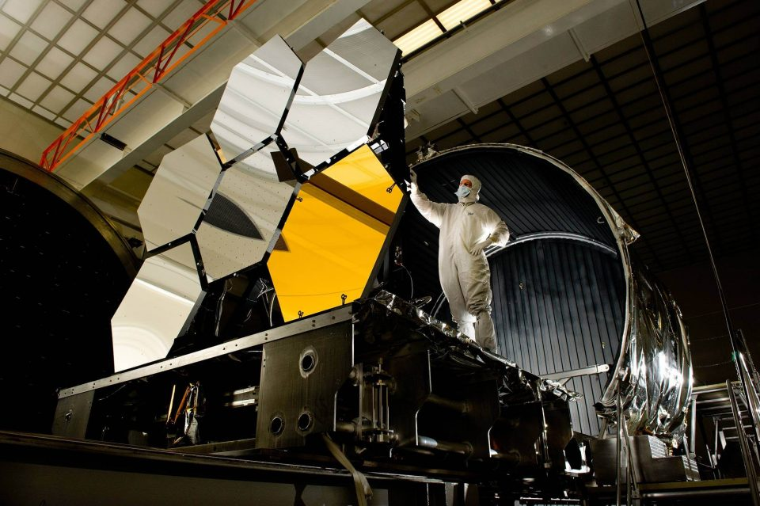
ABOUT MIRRORS IN JWST

Slide 6
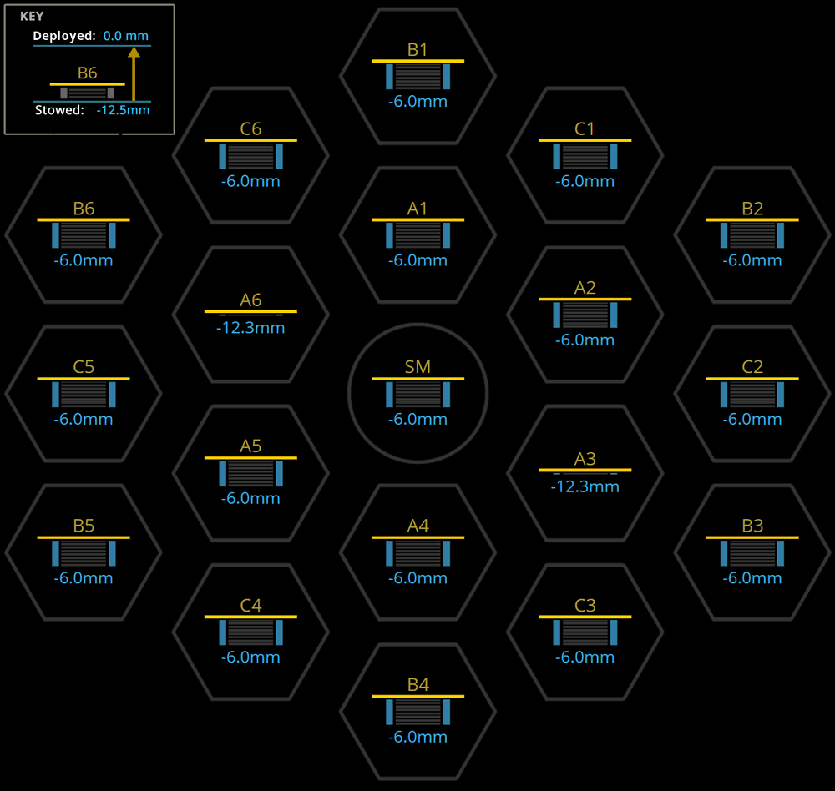
ABOUT MIRROR ARRANGEMENTS
It is designed to provide improved infrared resolution and sensitivity over hubble, viewing objects up to 100 times fainter and will enable a broad range of investigation across the fields of astronomy including observation up to redshift Z=20 of some of the oldest, most distant, events and objects in the universe such as the first stars and formation of the first galaxies, and allowing detailed atmospheric characterization potentially habitable exoplanets.

Slide 7
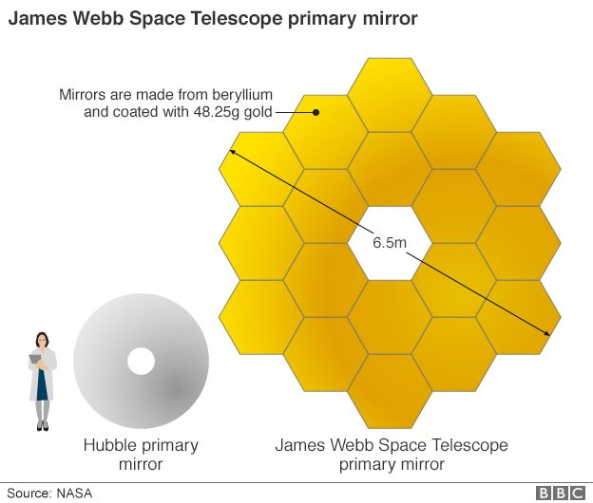
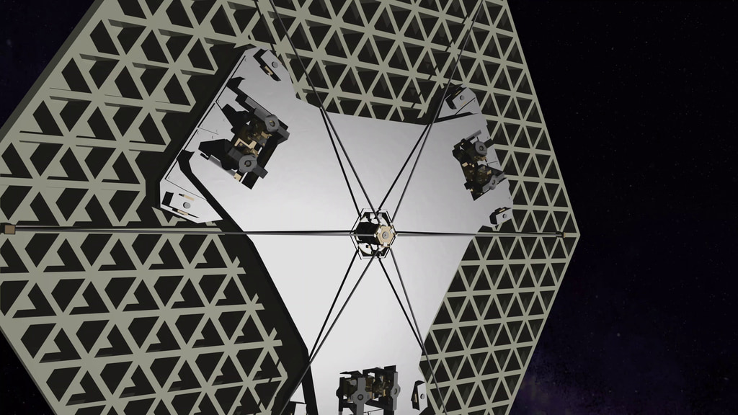
Focus of mirror:

Slide 8
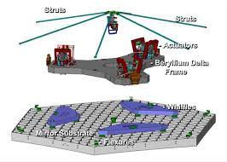
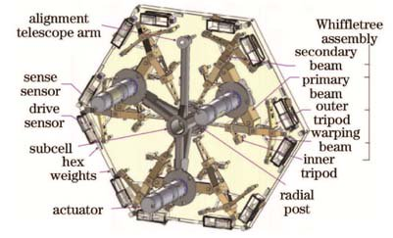

Slide 9
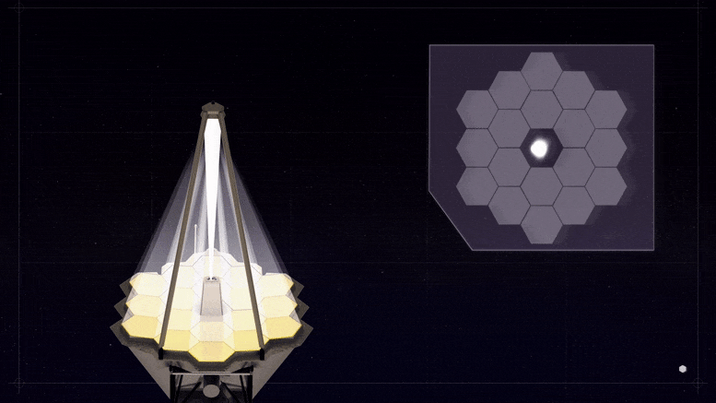
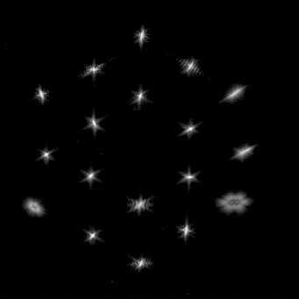

Slide 10
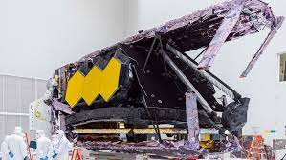
Launching: 25 December 2021 at 5:50 pm IST

Slide 11
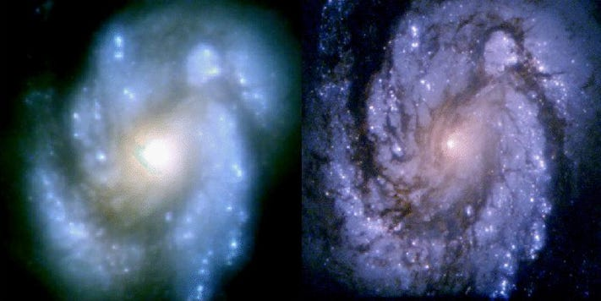
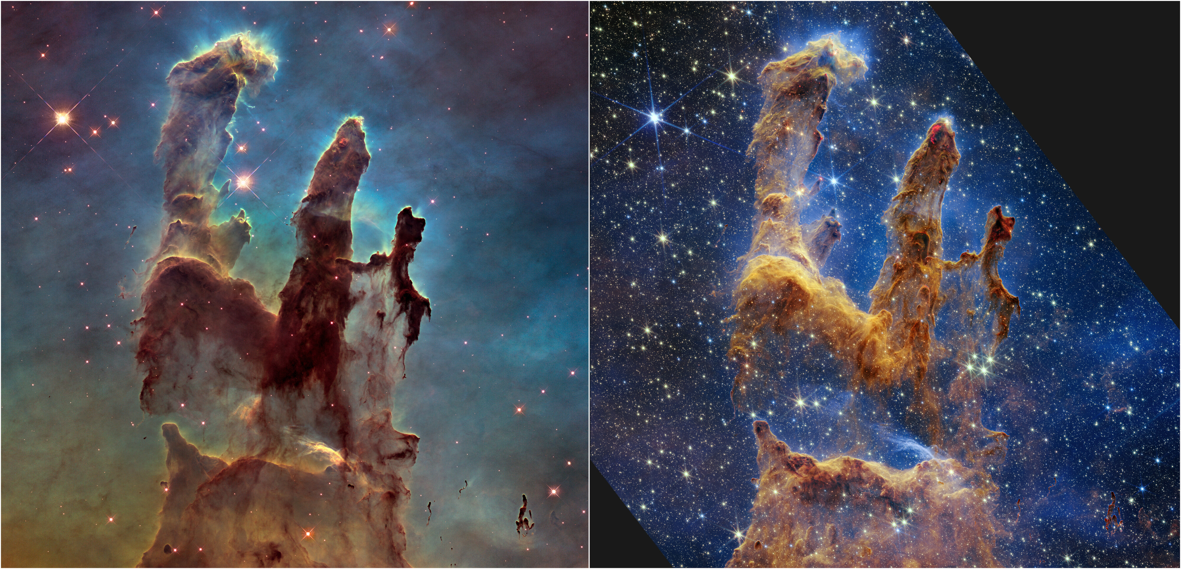
JWST VS HUBBLE:

Slide 12


